Slide 1
Prowess Brand Pulse
Transform Feedback into Foresight

Slide 2






Prowess Brand Pulse Approach & Framework
The Prowess Brand Pulse (Social Media Listening) delivers real-time brand intelligence by tracking sentiment, emotion and engagement—empowering teams to respond proactively and shape public brand perception.
Workforce & Investor Voice
Consumer & Community Input
Understand how employees, investors and professionals perceive your workplace and brand through, investor sentiment, and corporate engagement data.
Track public mentions, hashtags, and community discussions across open platforms to monitor consumer sentiment and external brand perception.
Social Media Listening
Unifies cross-platform feedback, detects emotion and sentiment trends, and transforms noise into actionable brand intelligence.
Sentiment Timeline
& Trends
Reports
& Sharing
Overall visualizing how brand sentiment has evolved over time across various platforms.
Export real-time insights and summaries for faster decision-making across marketing, PR, and HR teams.
Source-Level Brand
Analysis
Competitor
Benchmarking
Drill down into various source-wise sentiment, emotion, and topic-level trends for each platform.
Compare sentiment, visibility, and engagement across key competitors using strategic matrices.

Slide 3
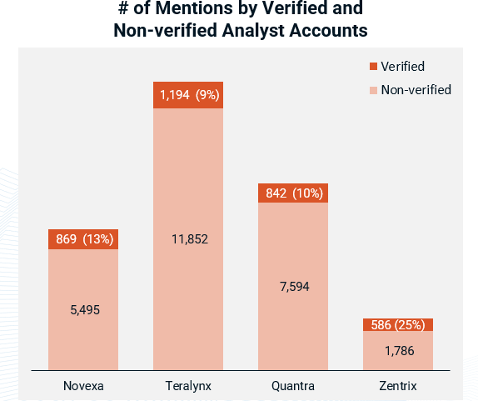
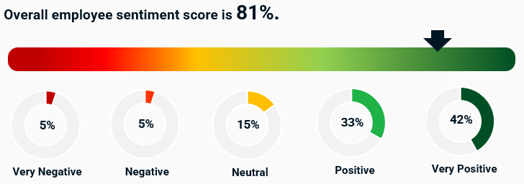
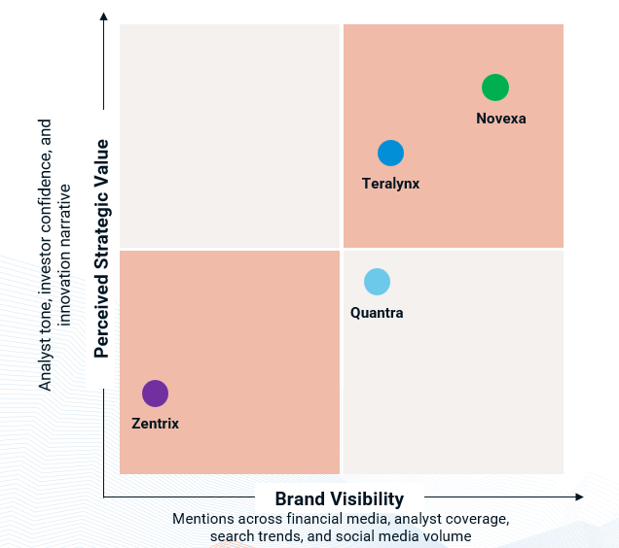
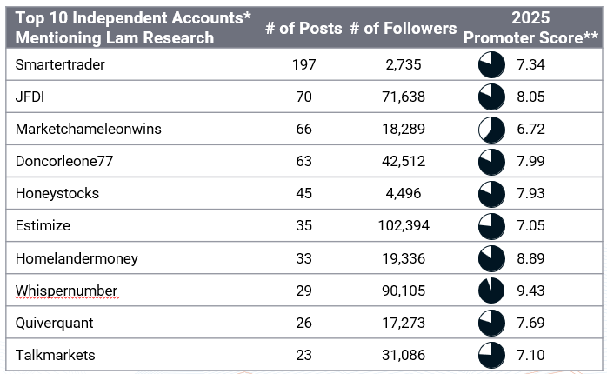
Case Study – Strategic Brand Intelligence with Brand Pulse
A global technology firm needed a unified view of brand perception across employees, customers, investors, and analysts to strengthen reputation and align stakeholder concerns.
Solution
The organization deployed Prowess Brand Pulse as a centralized platform to continuously monitor and analyze brand sentiment across key stakeholder groups—including employees, customers, investors, and analysts. By aggregating insights from platforms such as Glassdoor, Reddit, LinkedIn, X and financial media, Brand Pulse enabled real-time detection of sentiment shifts, emotional trends, and recurring themes. The platform's deep listening capabilities surfaced internal culture signals, external perception drivers, and content gaps, while also supporting strategic benchmarking. This unified intelligence layer equipped leadership with actionable insights to guide communications, employee experience, and brand strategy at scale.
Impact
The Brand Pulse platform enabled the company to proactively identify early reputational risks, address internal communication gaps, and refine external messaging around innovation and growth. Insights from employee sentiment revealed key areas for cultural and leadership improvement, while customer and investor feedback helped shape content and engagement strategies. By centralizing cross-stakeholder intelligence—from Glassdoor reviews to market sentiment—the organization improved alignment across marketing, HR, and executive leadership, ultimately strengthening brand trust, visibility, and strategic positioning.

Slide 4
Thank You!
Phone
+1.206.443.1117
Email
info@prowessconsulting.com
Web Address
https://prowessconsulting.com/
Address
US: 12100 Northup Way, Bellevue, WA 98005
India: Connekt, 12th Floor, Gala Empire, Drive In Rd, Ahmedabad, Gujarat 380052

